Slide 1
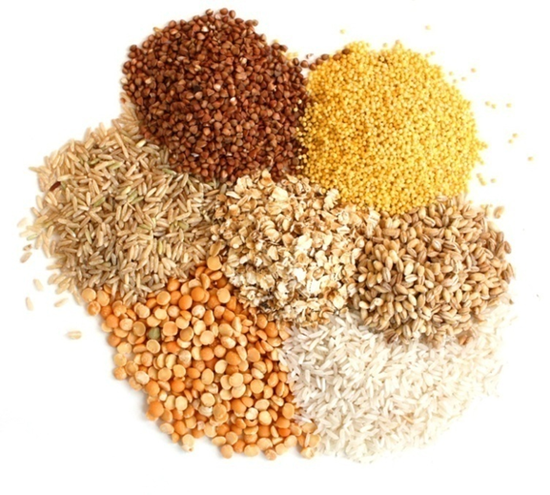
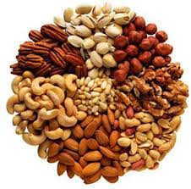
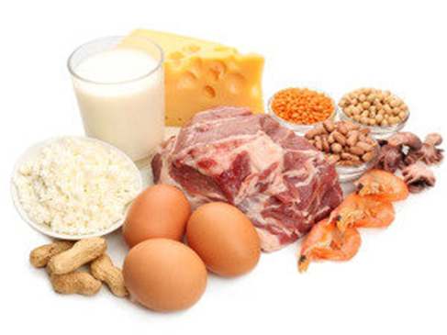
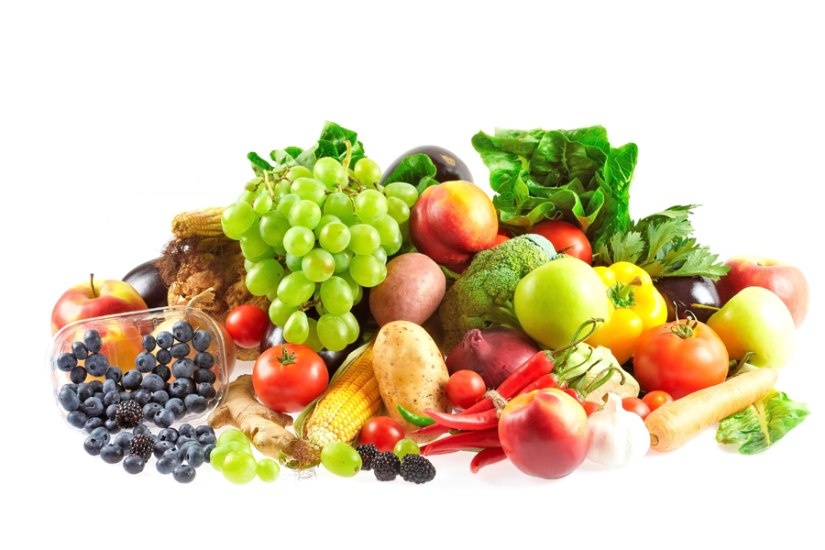
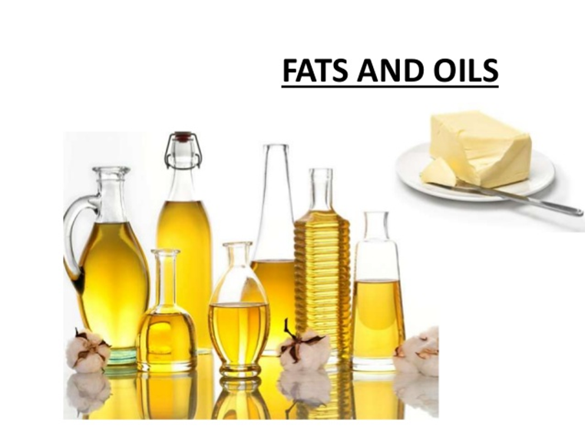
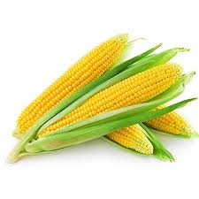
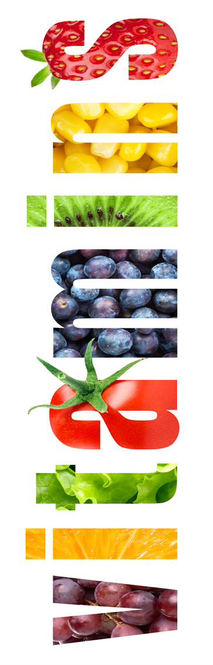
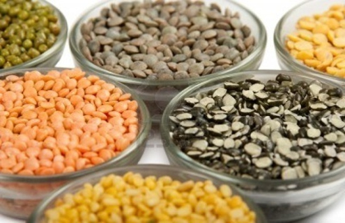
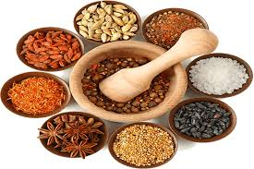
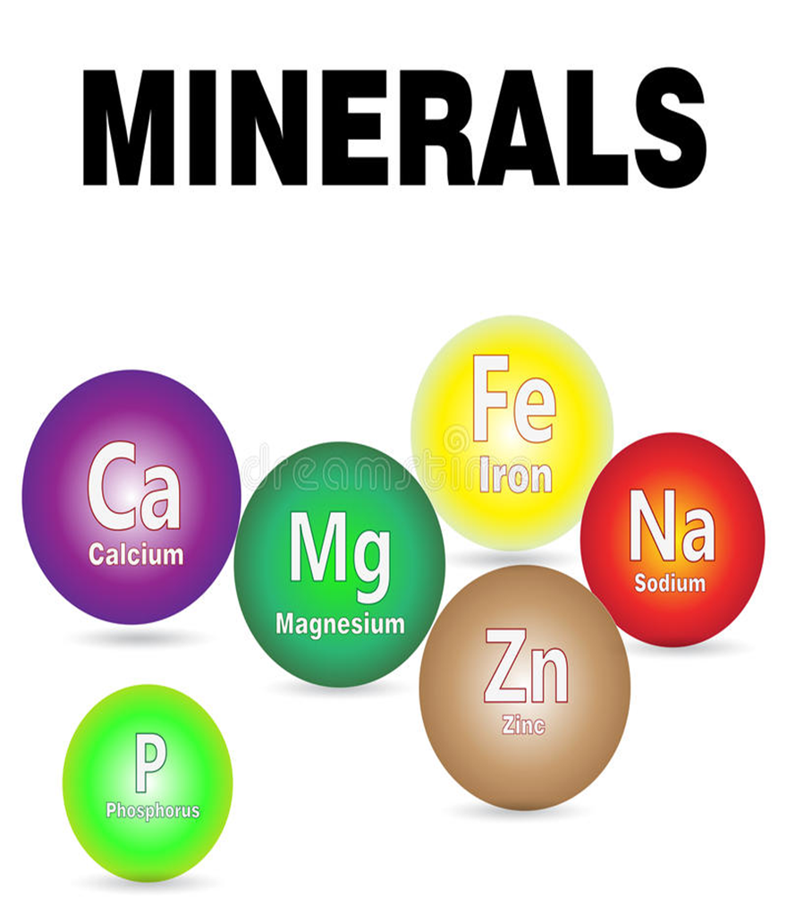
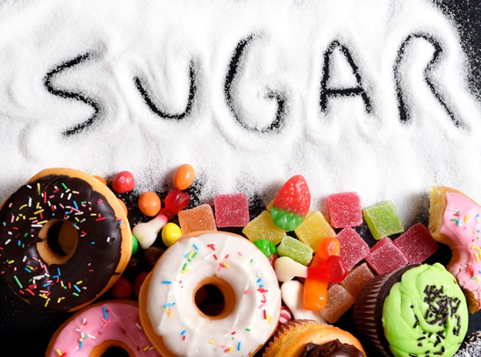
CLASSIFICATION OF FOOD

Slide 2
Definitions
Food: An Edible material consisting essential nutrients used in the body of an organism to sustain growth, repair, and vital processes and to furnish energy.
Nutrient: Nutrients are compounds in foods essential to life and health, providing us with energy, the building blocks for repair and growth and substances necessary to regulate chemical processes.
Diet: The kinds of food that a person, animal, or community habitually eats
Balanced Diet: A diet consisting of a variety of different types of food and providing adequate amounts of the nutrients necessary for good health.
Deficiency Diseases: A disease caused by the lack of an element in the diet, usually a particular vitamin or mineral.
Nutrition: The process of providing or obtaining the food necessary for health and growth.
Health: A state of complete physical, mental, and social well-being, not merely the absence of disease or infirmity

Slide 3

Do you know these people by profession ????
Dietitian
Nutritionist
Food Scientist

Slide 4
FOOD GROUP CLASSIFICATION
A food group is a collection of foods that share similar nutritional properties or biological classifications. Foods are classified accordingly as:
Classification by Origin
Classification by Functions
Classification by Chemical nature
Classification by Mass
Classification by Nutritive value

Slide 5
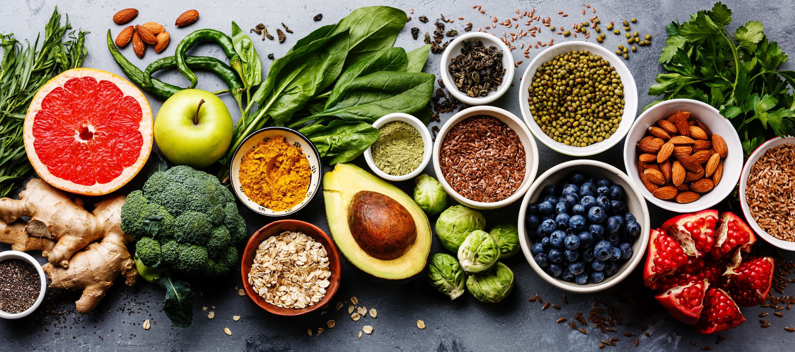

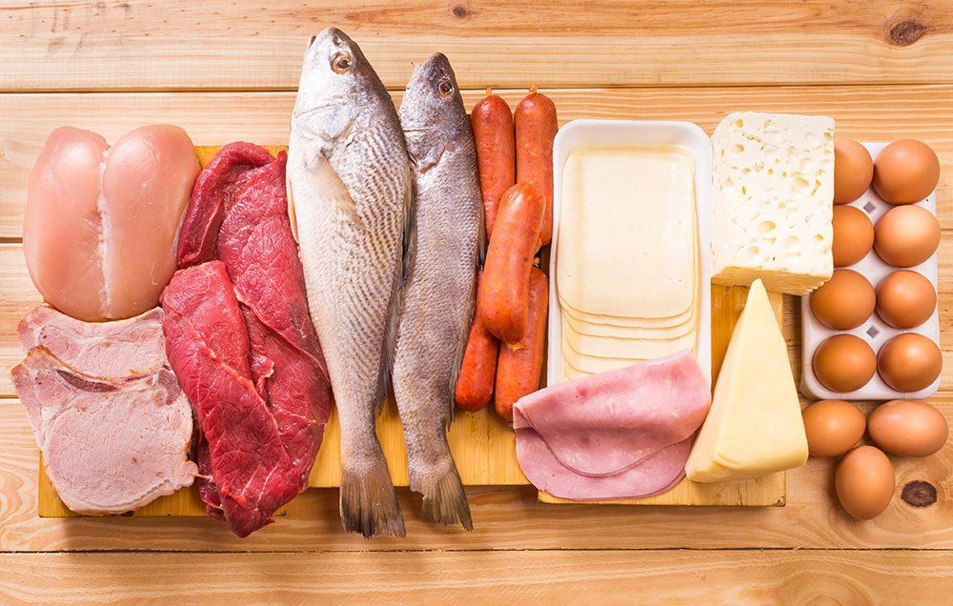
A. CLASSIFICATION OF FOOD BY ORIGIN
PLANT FOODS
ANIMAL FOODS

Slide 6
Have your heard about these terms????
Vegan?
Lacto Vegetarian?
Ovo Vegetarian?
Lacto Ovo Vegetarian?
Pollotarian?
Pescatarian?
Notes:
Vegan? – Does not consume Meat, meat by products (Gelatin, animal broths) , animal by products (Eggs, Dairy, honey) Does consume plant foods only
Lacto Vegetarian?- Does not consume Meat, , meat by products (Gelatin, animal broths) , animal by products (Eggs) Does consume dairy;
OVO vegan? – Does not consume Meat, Dairy by products (Milk and cheese) Does consume egg;
Lacto Ovo Vegetarian?- Does not consume Meat, Does consume egg and Dairy;
Pollotarian? Red meat- Does not consume Read meat, Fish sea foods Does consume pourltry, fowl, egg, dairy
Pescatarian?- Does not consume Read Meat(beaf, lamb, port, vension Poultry and fowl Does consume fish and seafood's, eggs, dairy

Slide 7
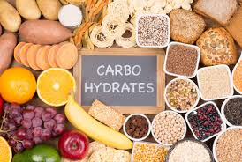
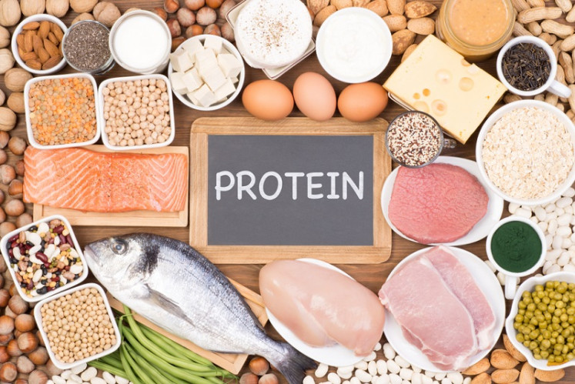
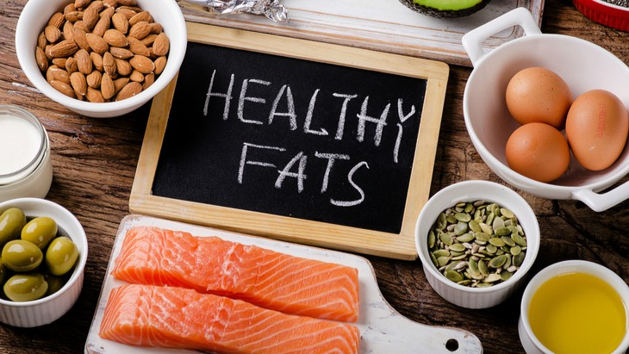
B. CLASSIFICATION BY FUNCTIONS
ENERGY YIELDING FOODS
BODY BUILDING FOODS
PROTECTIVE FOODS
Foods which nourishes the body is classified according to their function and food groups.
ENERGY YIELDING FOODS
This group includes foods rich in carbohydrate, fat and protein. They may be broadly divided into two groups.
Cereals, pulses, roots and tubers: Cereals provide in addition to energy large amounts of proteins, minerals and vitamins in the diet. Pulses also give protein and B vitamins besides giving energy to the body.
Fats, Oils and pure carbohydrates like sugars: Sugars provide only energy and fats provide concentrated source of energy

Slide 8
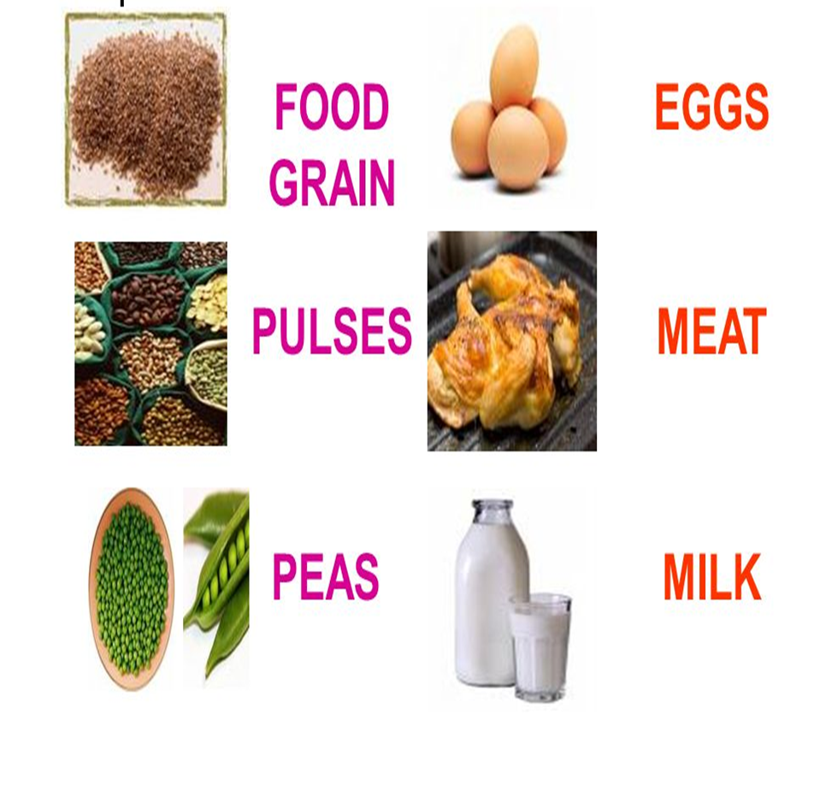
BODY BUILDING FOODS
Foods rich in protein are called body building foods. They are classified into two groups.
Milk, egg, meat & fish: They are rich in proteins of high biological value. These proteins have all the essential amino acids in correct proportion for the synthesis of body tissues.
Pulses, nuts and oilseeds: They are rich in protein but may not contain all the essential amino acids required by the human body.

Slide 9
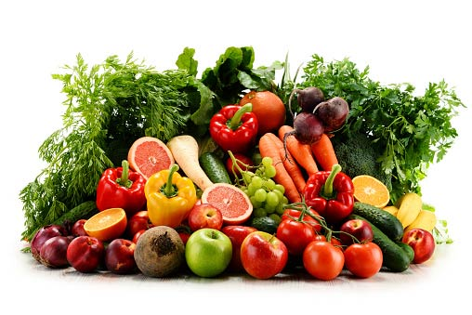
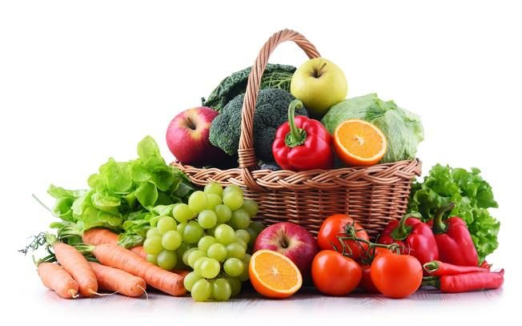
PROTECTIVE FOODS
Foods rich in protein, vitamins and minerals have regulatory functions in the body like maintaining the heartbeat, water balance, temperature, etc.
Protective foods are broadly classified into two groups.
Foods rich in vitamins and minerals and proteins of high biological value (eg) milk, egg, and fish.
Foods rich in certain vitamins and minerals only (eg) green leafy vegetables and fruits.

Slide 10
Which functional group will you match the following foods
A cup of green peas
A bowl of Barley
Dried Raising, Dates, Figs etc.

Slide 11
C. CLASSIFICATION BY CHEMICAL PROPERTIES
The dietary components of foods are classified according to its chemical nature like:
Carbohydrates
Proteins
Fats
Vitamins
Minerals
Dietary Fiber
Water

Slide 12
D. CLASSIFICATION BY MASS
Depending on the quantity required for cells and organisms foods are classified as:
MACRONUTRIENTS
Macronutrients are required in large quantities daily.
These nutrients includes in substrates in metabolic process for energy.
They include. CARBOHYDRATE, PROTEINS & ENERGY
MICRONUTRIENTS
Micronutrients are required in smaller quantities (usually in less than milligrams).
They are involved in regulating metabolism and energy process but not as substrates.
They include. VITAMINS AND MINERALS

Slide 13
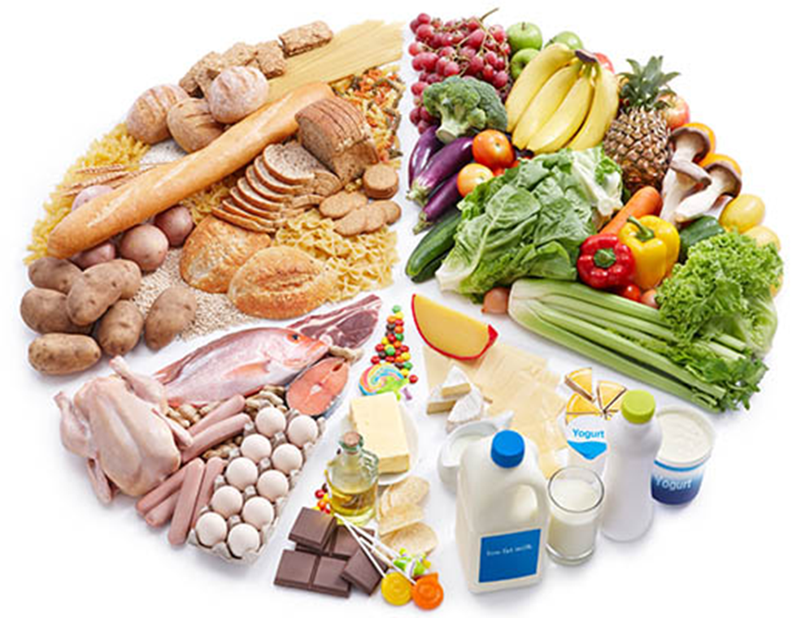
E.CLASSIFICATION BY NUTRITIVE VALUE
Cereals and millets
Pulses (Legumes)
Nuts and oilseeds
Vegetables
Fruits
Milk and milk products
Eggs
Meat, fish and other animal foods
Fats and oils
Sugar and other carbohydrate foods
Spices and condiments

Slide 14
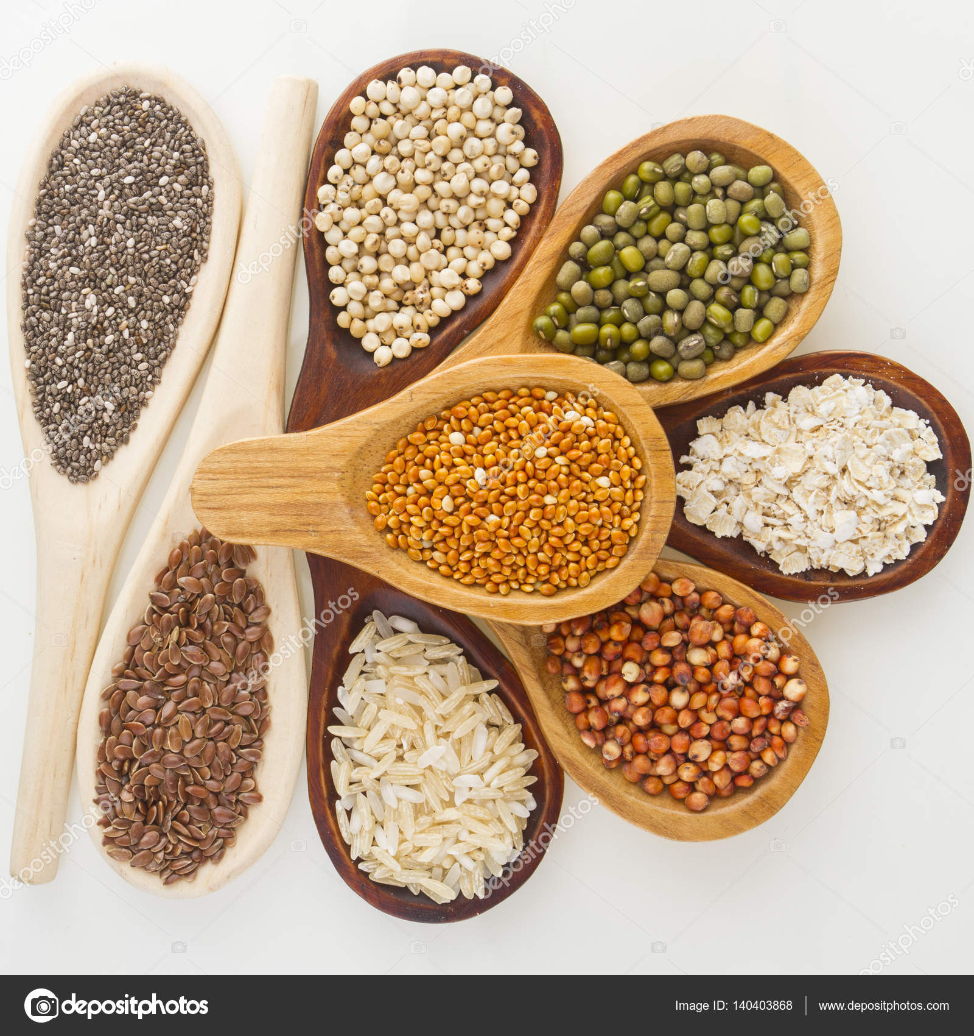
CEREALS AND MILLETS
They form the staple food of a large majority of the population
They form about 70 to 80 per cent of the diets
They contain about 6 to 12 per cent proteins and are good sources of some vitamins
Cereals are deficient in Vitamins A, D, B12 and C.
Millets also belong to cereals groups
Ragi is one of the richest sources of Calcium containing about 344 mg/100g.

Slide 15
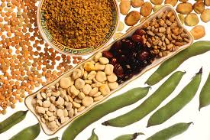
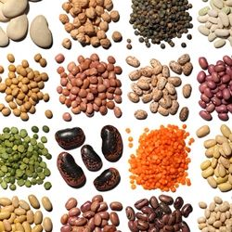
PULSES AND LEGUMES
Dried whole beans are pulses/legumes rich in proteins containing about 19 to 24 per cent.
Broken pulses/legumes are called dhals/lentils
They are good sources of many B vitamins and minerals
Deficient in vitamins A, D, B12 and C.
Tender pulses e.g., green Bengal gram, green peas, green field beans etc., contain fair amounts of vitamin C.
Further germination of pulses enhances the vitamin C content.

Slide 16
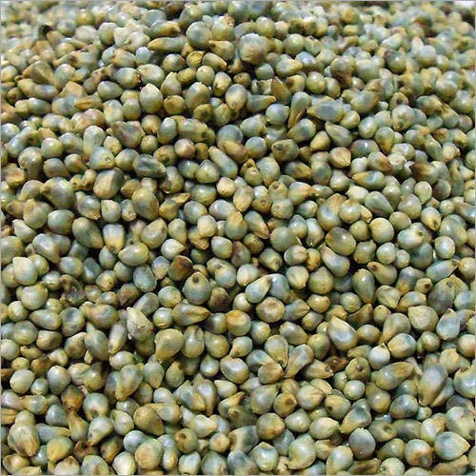
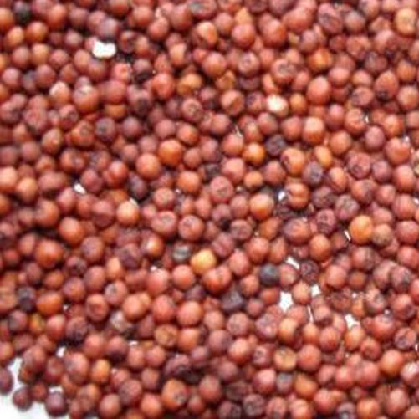
Identify the Foods

Slide 17
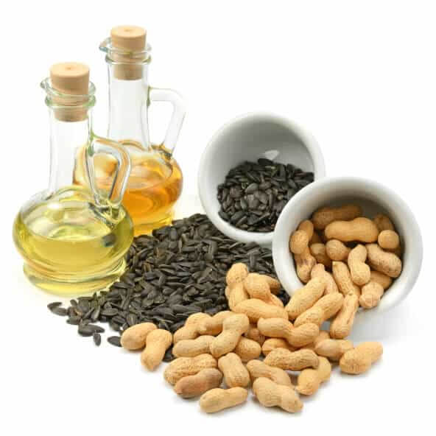
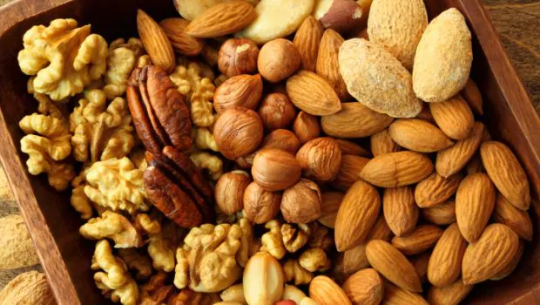
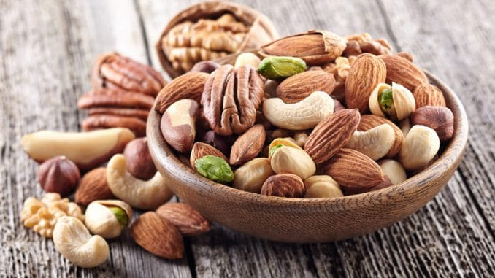
NUTS AND OIL SEEDS
They contain about 18-40 per cent proteins.
Soybean is the richest source of proteins containing about 40%, along with B-vitamins, vitamin E, phosphorus and Iron.
They do not contain Vitamin A, D, B12 and C.
Oilseeds can be used for the preparation of milk substitutes

Slide 18
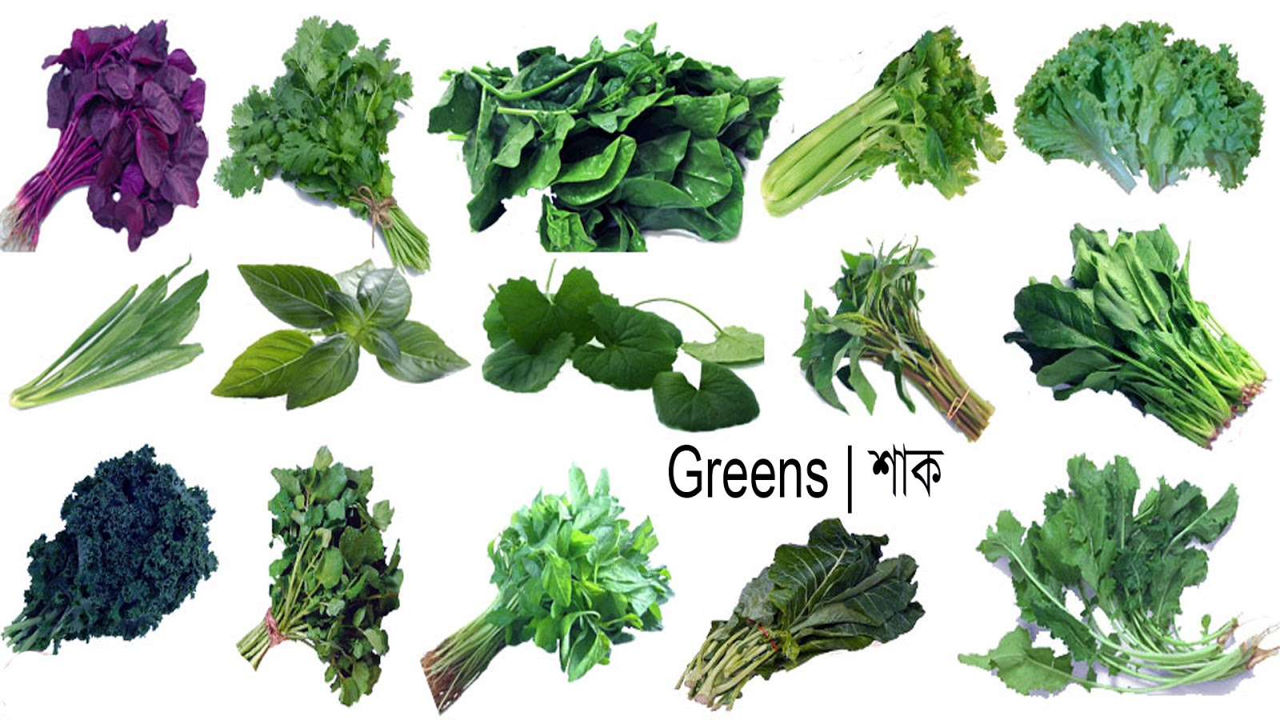
VEGETABLES
Vegetables may be broadly divided into three groups from the nutritional point of view
1. Green leafy vegetables 2. Roots and tubers 3. Other vegetables
Green Leafy Vegetables
Green leafy vegetables are rich in β carotene (provitamin A)
They are good sources of calcium, riboflavin, folic acid and vitamin C
They are the cheapest among the protective foods.

Slide 19
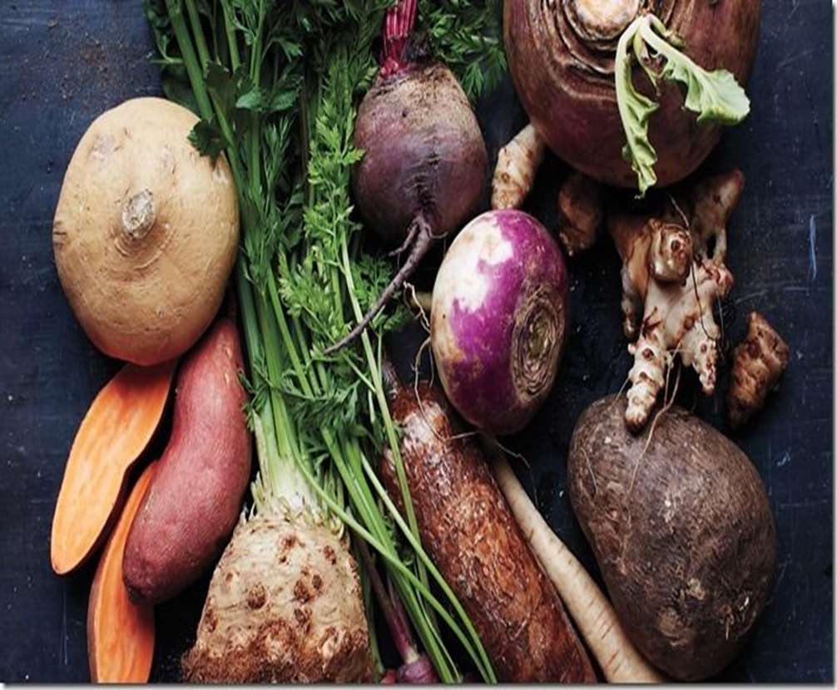
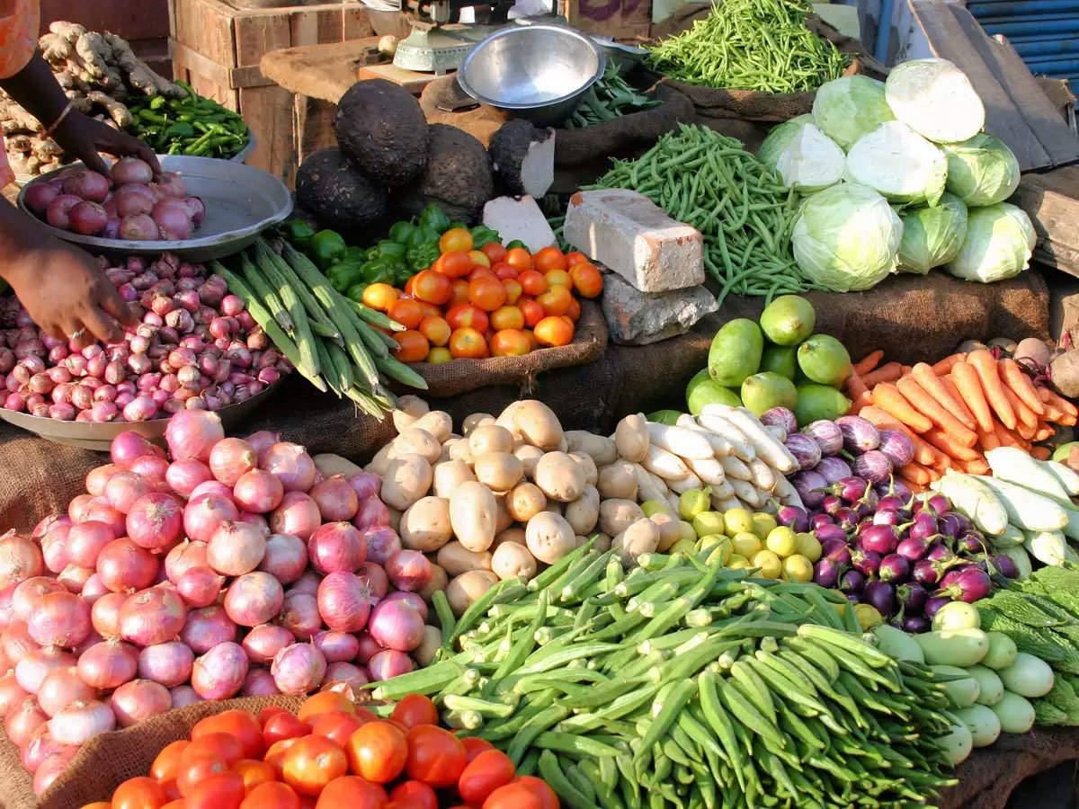
ROOTS AND TUBERS:
The important foods in this group are potato, sweet potato, tapioca, carrot elephant yam and colocasia.
They are, in general, good sources of carbohydrate.
They are, however, poor sources of proteins, except potato which is a fair source.
Other Vegetables:
This group includes a large number of vegetables.
Some of them are good sources of Vitamin C.
Yellow pumpkin is a fair source of β carotene.

Slide 20
vegetable group – Say yes/No
Ginger and Garlic belongs to Roots and tubers - Yes /No
Brussels, cabbage, Brocolli belongs to Other vegetables group- Yes/No
Onion, Sweet potato, Yam does not belong to vegetable goups- Yes/No

Slide 21
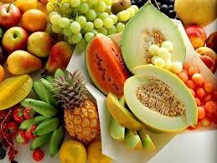
FRUITS
Mango and papaya are in general good sources of β carotene, Amla and guava are very rich in vitamin C.
Tomato, citrus, papaya, cashew apple and pineapple are also the richest source of Vitamin C.
Apple, banana and grapes are poor sources of vitamin C.
Yellow colour fruits are rich source of Beta-carotene (Vit A)

Slide 22
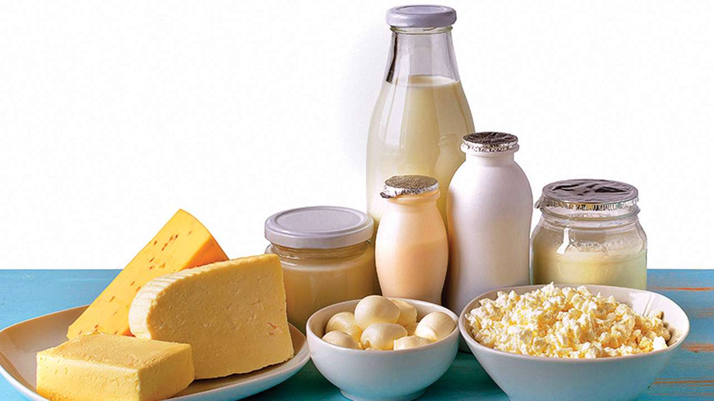
MILK AND MILK PRODUCTS
Milk is a food for infants and supplement to the diets of children and adults.
Milk is almost a complete food except for iron and vitamin C.
Milk proteins are of high biological value - 100 ml of cow’s milk provides about 3.2g protein, 4.1g fat, 120 mg calcium, 0.19 mg riboflavin, 53µg of vitamin A and substantial amounts of B-vitamins and minerals.
Fat content of buffalo milk is twice the amount present in cow’s milk.

Slide 23
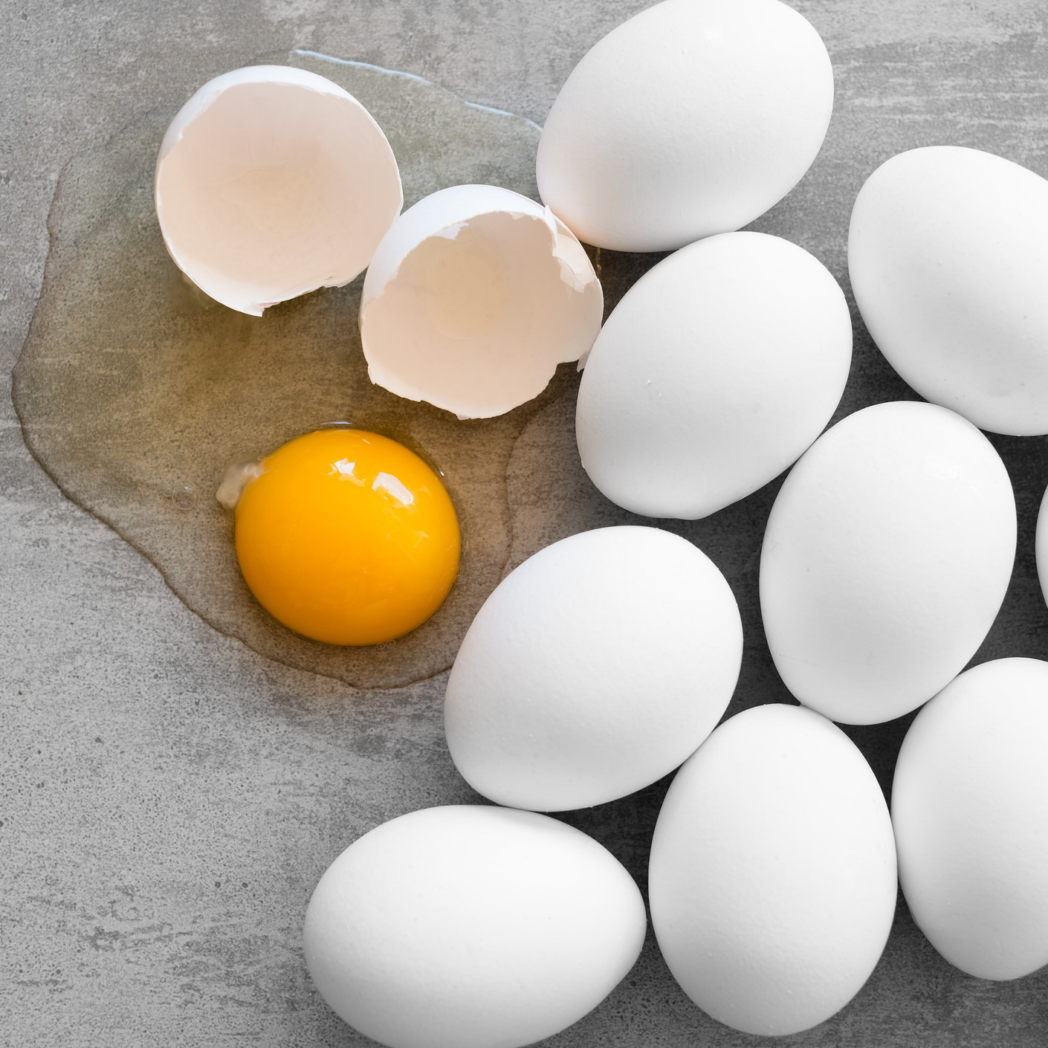
EGGS
Hen’s egg contains about 13 per cent protein of very high biological value and 13 per cent fat.
It is a rich source of vitamin A and some B –vitamins. It is a fair source of vitamin D but doesn’t contain Vitamin C.
Egg white contains about 12 per cent proteins and some B-vitamins and devoid of fat and vitamin A.
Egg yolk contains about 15 per cent proteins and 3 per cent fat. It’s a rich source of vitamin A and fair source of Iron, B-vitamins and vitamin –D.

Slide 24
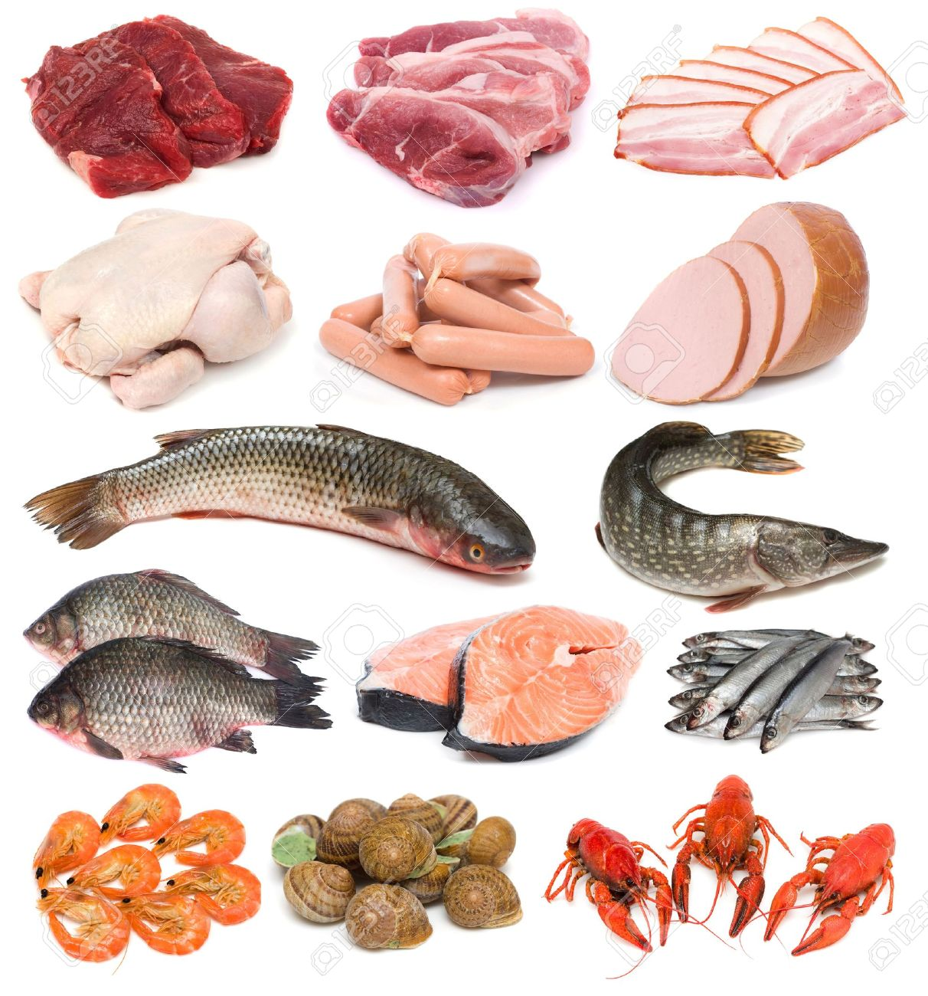
Meat, Fish and other Animal foods
Meat is rich in proteins (18-22 per cent) of high biological value.
It is fair source of B-vitamins.
It does not contain Vitamin A, C or D and fibre.

Slide 25
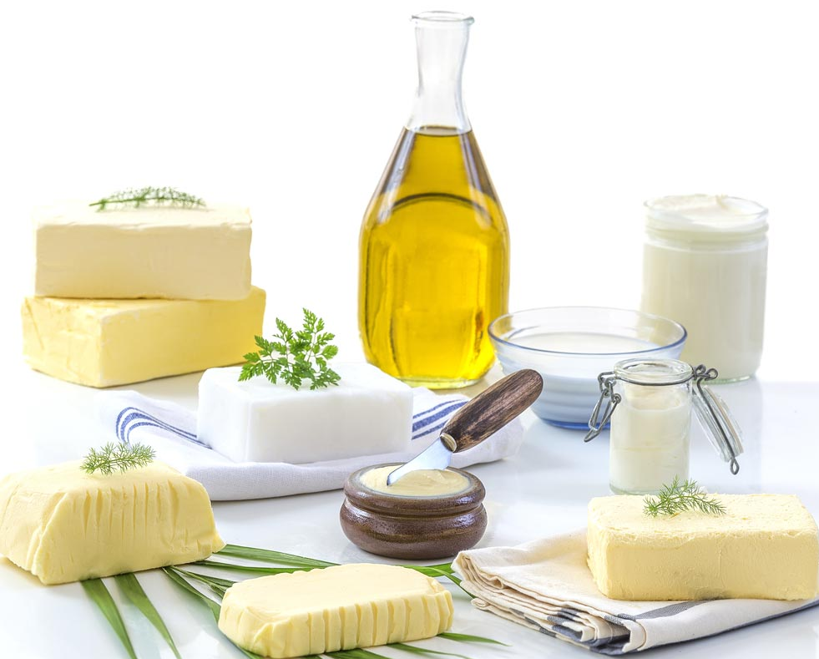
FATS AND OILS
They serve as source of energy and provide the essential fatty acids.
Butter, ghee and vitamin A.
Many of them are vanaspathi are good source of vitamin A (2500 IU per 100g).
The common vegetable oils and fats do not contain carotene and food source of Vitamin E.

Slide 26
How Well Do You Know Your Favorite Foods ?
Egg lack _____________ Vitamins
What fruit is native to southern Asia, and is the most dominant tropical fruit variety produced worldwide?- Fruit when raw is rich in Vita C and when ripe is good source of Vita A
Which country is the biggest producer of dates?

Slide 27
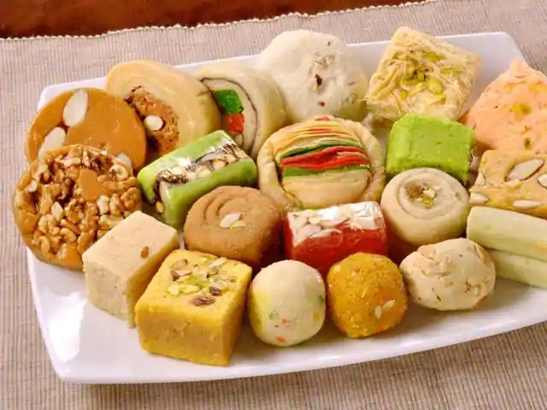

SUGARS AND CARBOHYDRATES
The carbohydrate foods commonly used are cane sugar, jaggery, glucose, honey, syrup, custard powder, arrowroot flour and sago.
They serve mainly as a source of energy.
Honey and jaggery contain limited quantities of minerals and vitamins.

Slide 28
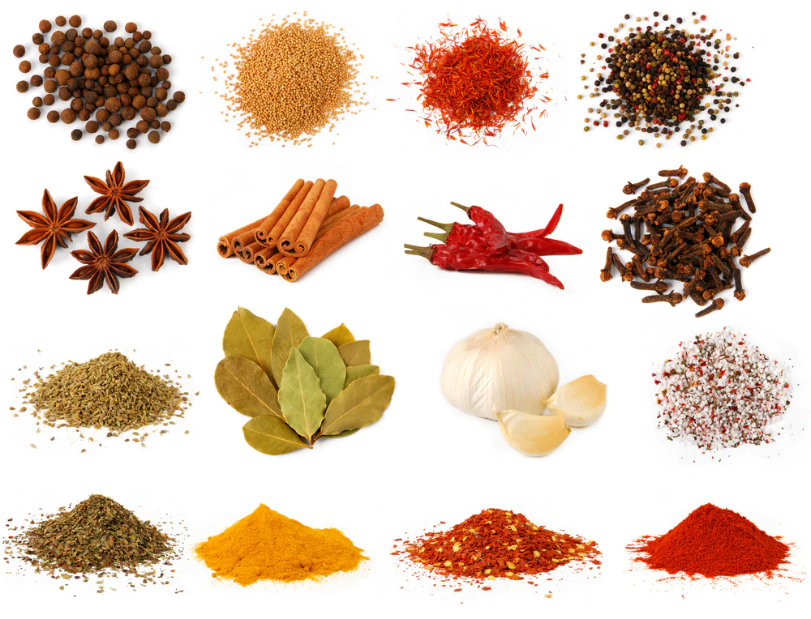
CONDIMENTS AND SPICES
Spices and Condiments are not important sources of nutrient in average diets, but it enhances the palatability of the diet and play a functional role.
The flavour principles present in them help to improve the flavour and acceptability of food preparations.
Spices are the treasure of antioxidants and health promoting components.

Slide 29
SIGNIFICANCE OF FOOD GROUP CLASSIFICATION
Planning wholesome balanced menus to achieve nutritional adequacy.
Assessing nutritional status – a brief diet history of an individual can disclose inadequacies of food and nutrients from any of the five groups.

Slide 30
REFERENCE BOOKS
Food Science- Srilakshmi, Prosper Montague Publishing Group Ltd., Hamlyn, London. 2003.
Food & Nutrition- Swaminathan, The Bangalore Printing & publishing co ltd., Vol I, Second Edition, Bangalore (1995).
An Introduction to Lifestyle Management: Facilitator’s Handbook, Dr.Anja Morris-Paxton, 2019
DEVELOPED RESOURCE MATERIALS
Classification of Foods- Developed PDF attached in Ample course content
LOCAL VIDEO DEVELOPED:
Food Groups/Food Pyramid- Video is available in Ample course content

Slide 31
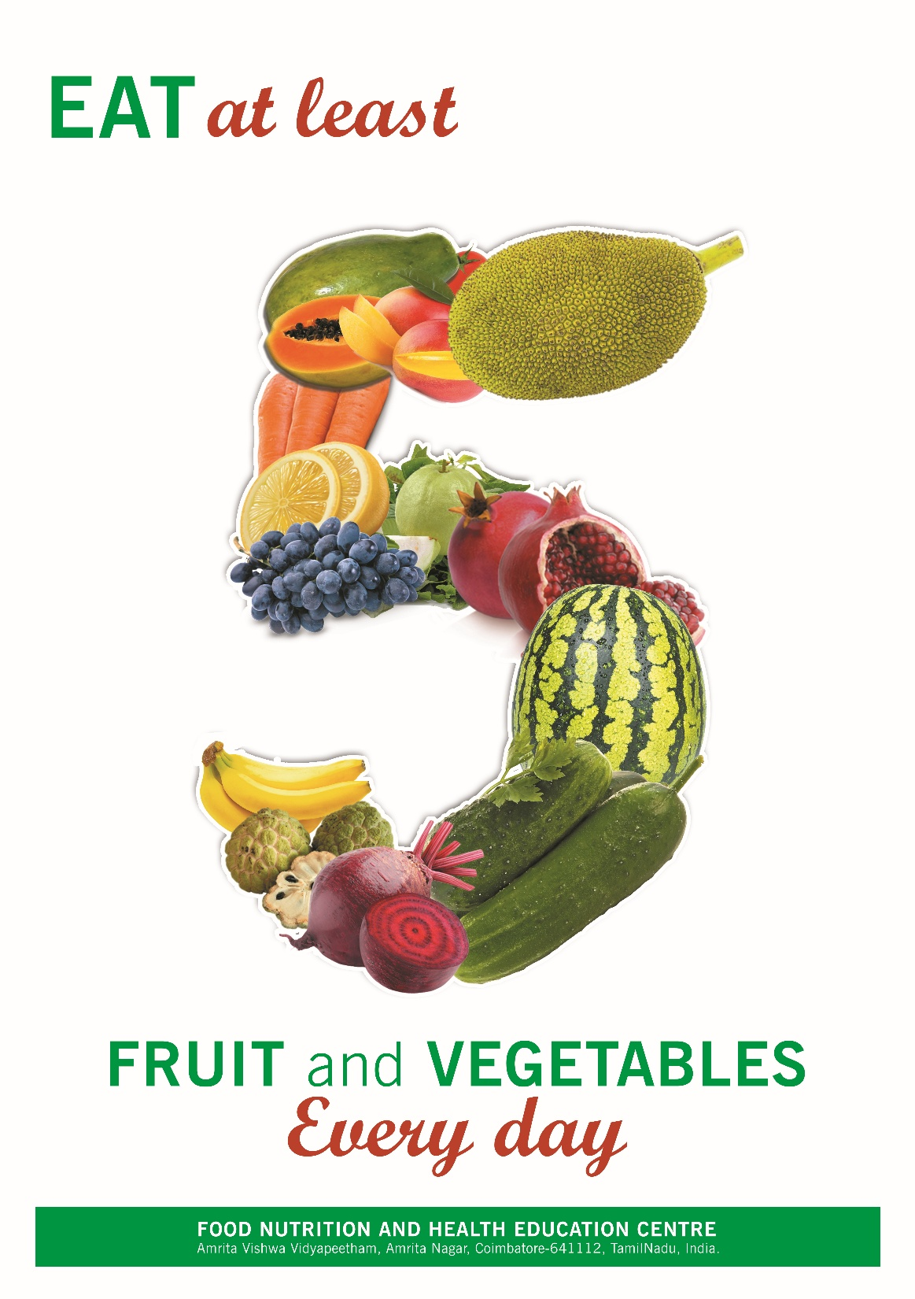
TAKE HOME
3 Veggies
2 Fruits

